Slide 1
Data Science
NumPy

Slide 2
Introduction NumPy
NumPy stands for ‘Numerical Python’.
It is a package for data analysis and scientific computing
with Python.
NumPy uses a multidimensional array object, and has functions and tools
for working with these arrays.
The powerful n dimensional array in NumPy speeds-up data
processing.
The NumPy library has a large set of routines (built-in functions) for creating, manipulating,and transforming NumPy arrays.

Slide 3
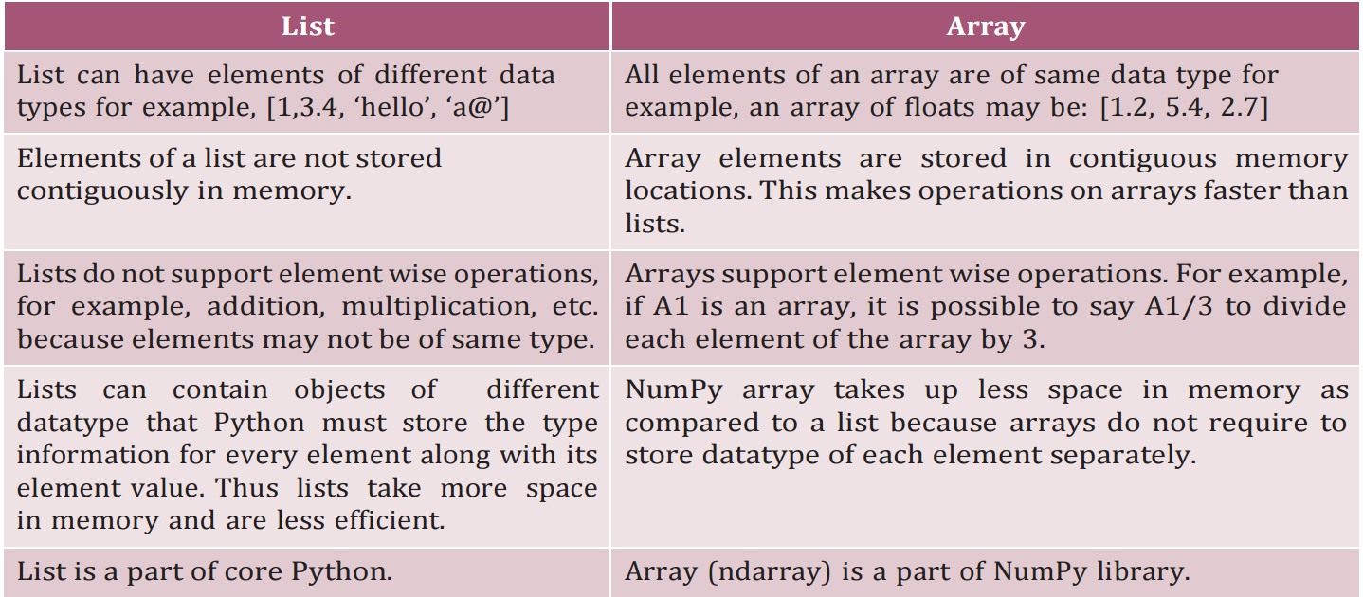

Slide 4
Creation of NumPy Arrays from List
Installing NumPy
NumPy can be installed by typing following command:
pip install NumPy
There are several ways to create arrays. To create an array and to use its methods, first we need to import the NumPy library.
The NumPy’s array() function converts a given list into an array. For example,
array1 = np.array([10,20,30])
print(array1)
Result:
array([10, 20, 30])

Slide 5
Creation of NumPy Arrays from List
Creating a 1-D Array
An array with only single row of elements is called 1-D array. Let us try to create a 1-D array from a list which contains numbers as well as strings.
>>> array2 = np.array([5,-7.4,'a',7.2])
>>> array2array(['5', '-7.4', 'a', '7.2'],dtype='<U32')
Observe that since there is a string value in the list, all integer and float values have been promoted to string, while converting the list to array.
Note: U32 means Unicode-32 data type.

Slide 6
Creation of NumPy Arrays from List
Creating a 2-D Array
We can create a two dimensional (2-D) arrays by passing nested lists to the array() function.
>>> array3 = np.array([[2.4,3],[4.91,7],[0,-1]])
A list is called nested list when each element is a list itself.
print(array3)
Result:
array([[ 2.4 , 3. ],
[ 4.91, 7. ],
[ 0. , -1. ]])
Observe that the integers 3, 7, 0 and -1 have beenpromoted to floats

Slide 7
Attributes of NumPy Array
Some important attributes of a NumPy ndarray object are:
1) ndarray.ndim: gives the number of dimensions of the array as an integer value. Arrays can be 1-D, 2-D or n-D. In this chapter, we shall focus on 1-D and 2-D arrays only. NumPy calls the dimensions as axes (plural of axis).
Thus, a 2-D array has two axes. The row-axis is called axis-0 and the column-axis is called axis-1. The number of axes is also called the array’s rank.
>>> array1.ndim
1
>>> array3.ndim
2
2) ndarray.shape: It gives the sequence of integers indicating the size of the array for each dimension.
>>> array1.shape
(3,)
>>> array3.shape
(3, 2)

Slide 8
3) ndarray.size: It gives the total number of elements of the array. This is equal to the product of the elements of shape.
>>> array3.size
6
4) ndarray.dtype: is the data type of the elements of the array. All the elements of an array are of
same data type. Common data types are int32, int64, float32, float64, U32, etc.
>>> array1.dtype
dtype('int32’)
5) ndarray.itemsize: It specifies the size in bytes of each element of the array. Data type int32 and
float32 means each element of the array occupies 32 bits in memory. 8 bits form a byte. Thus, an
array of elements of type int32 has itemsize 32/8=4 bytes. Likewise, int64/float64 means each item
has itemsize 64/8=8 bytes.
>>> array1.itemsize
4

Slide 9
Other Ways of Creating NumPy Arrays
We can specify data type (integer, float, etc.) while creating array using dtype as an argument to array(). This will convert the data automatically to the mentioned type.
Example:
array4 = np.array( [ [1,2], [3,4] ],dtype=float)
Think and Reflect When we may require to create an array initialised to zeros or ones?
print(array4)
Result:
[[1., 2.],
[3., 4.]]

Slide 10
Other Ways of Creating NumPy Arrays
2. We can create an array with all elements initialized to 0 using the function zeros(). By default, the data type of the array created by zeros() is float. The following code will create an array with 3 rows and 4 columns with each element set to 0.
array5 = np.zeros((3,4))
[[0., 0., 0., 0.],
[0., 0., 0., 0.],
[0., 0., 0., 0.]]
3. We can create an array with all elements initialized to 1 using the function ones(). By default, the data type of the array created by ones() is float. The following code will create an array with 3 rows and 2 columns.
array6 = np.ones((3,2))
[[1., 1.],
[1., 1.],
[1., 1.]]

Slide 11
Other Ways of Creating NumPy Arrays
4. We can create an array with numbers in a given range and sequence using the arange() function. This function is analogous to the range() function of Python.
array7 = np.arange(6)
print(array7)
array([0, 1, 2, 3, 4, 5])
array8 = np.arange( -2, 24, 4 )
print(array8)
array([-2, 2, 6, 10, 14, 18, 22])

Slide 12
INDEXING AND slicing
NumPy arrays can be indexed, sliced and iterated over.
A=np.array([7,8,9,6,70])
print(A[2]) output 9
print(A[1:3]) output 8,9
D=np.array([[4,5,6],[7,8,9],[3,5,6]])
print(D[2][2]) output 6

Slide 13
Arithmetic Operations
Arithmetic operations on NumPy arrays are fast and simple. When we perform a basic arithmetic operation like addition, subtraction, multiplication, division etc. on two arrays, the operation is done on each corresponding pair of elements. For instance, adding two arrays will result in the first element in the first array to be added to the first element in the second array, and so on. Consider the following element-wise operations on two arrays:
>>> array1 = np.array([[3,6],[4,2]])
>>> array2 = np.array([[10,20],[15,12]])

Slide 14
Arithmetic Operations
#Element-wise addition of two matrices.
>>> array1 + array2
array([[13, 26],
[19, 14]])
#Subtraction
>>> array1 - array2
array([[ -7, -14],
[-11, -10]])
#Multiplication
>>> array1 * array2
array([[ 30, 120],
[ 60, 24]])

Slide 15
Arithmetic Operations
#Matrix Multiplication
>>> array1 @ array2
array([[120, 132],
[ 70, 104]])
#Exponentiation
>>> array1 ** 3
array([[ 27, 216],
[ 64, 8]], dtype=int32)
#Division
>>> array2 / array1
array([[3.33333333, 3.33333333],
[3.75 , 6. ]])
#Element wise Remainder of Division
#(Modulo)
>>> array2 % array1
array([[1, 2],
[3, 0]], dtype=int32)

Slide 16
Arithmetic Operations
It is important to note that for element-wise
operations, size of both arrays must be same. That is,
array1.shape must be equal to array2.shape

Slide 17
Transpose
Transposing an array turns its rows into columns and
columns into rows just like matrices in mathematics.
#Transpose
>>> array3 = np.array([[10,-7,0, 20],
[-5,1,200,40],[30,1,-1,4]])
NOtEs
>>> array3
array([[ 10, -7, 0, 20],
[ -5, 1, 200, 40],
[ 30, 1, -1, 4]])
# the original array does not change
>>> array3.transpose()
array([[ 10, -5, 30],
[ -7, 1, 1],
[ 0, 200, -1],
[ 20, 40, 4]])

Slide 18
Sorting
Sorting is to arrange the elements of an array in
hierarchical order either ascending or descending. By
default, numpy does sorting in ascending order.
>>> array4 = np.array([1,0,2,-3,6,8,4,7])
>>> array4.sort()
>>> array4
array([-3, 0, 1, 2, 4, 6, 7, 8])

Slide 19
Sorting 2D
In 2-D array, sorting can be done along either of the axes i.e., row-wise or column-wise. By default, sorting is done row-wise (i.e., on axis = 1). It means to arrange elements in each row in ascending order. When axis=0, sorting is done column-wise, which means each column is sorted in ascending order.
>>> array4 = np.array([[10,-7,0, 20],
[-5,1,200,40],[30,1,-1,4]])
>>> array4
array([[ 10, -7, 0, 20],
[ -5, 1, 200, 40],
[ 30, 1, -1, 4]])
#default is row-wise sorting
>>> array4.sort()
>>> array4
array([[ -7, 0, 10, 20],
[ -5, 1, 40, 200],
[ -1, 1, 4, 30]])

Slide 20
Sorting 2D
>>> array5 = np.array([[10,-7,0, 20],
[-5,1,200,40],[30,1,-1,4]])
#axis =0 means column-wise sorting
>>> array5.sort(axis=0)
>>> array5
array([[ -5, -7, -1, 4],
[ 10, 1, 0, 20],
[ 30, 1, 200, 40]])

Slide 21
CONCATENATING ARRAYS
Concatenation means joining two or more arrays.
Concatenating 1-D arrays means appending the sequences one after another.
L1=np.array([89,78])
L2=np.array([40,60,90])
A1=np.concatenate((L1,L2),dtype='int')
print(A1)
Can be used to concatenate two or more 2-D arrays either row-wise or column-wise. All the dimensions of the arrays to be concatenated must match exactly except for the dimension or axis along which they need to be joined.
Any mismatch in the dimensions results in an error. By default, the concatenation of the arrays happens along axis=0.

Slide 22
CONCATENATING ARRAYS
Axis 0 − Axis 0 refers to the rows of a data frame or a Series. It is often referred to as the "index axis". When an operation is applied along axis 0, it means that the operation is applied to each row of the Data Frame or Series.
Axis 1 − Axis 1 refers to the columns of a data frame or a Series. It is often referred to as the "column axis". When an operation is applied along axis 1, it means that the operation is applied to each column of the Data Frame or Series.
L1=np.array([[89,78],[88,90]])
L2=np.array([[40,60],[7,7],[4,56]])
A1=np.concatenate((L1,L2),axis=0)
print(A1)
Result:
[[89 78]
[88 90]
[40 60]
[ 7 7]
[ 4 56]]

Slide 23
CONCATENATING ARRAYS
L1=np.array([[89,78],[88,90],[0,0]])
L2=np.array([[40,60],[7,7],[4,56]])
A1=np.concatenate((L1,L2),axis=1)
print(A1)
Result:
[[89 78 40 60]
[88 90 7 7]
[ 0 0 4 56]]

Slide 24
RESHAPING ARRAYS
We can modify the shape of an array using the reshape() function. Reshaping an array cannot be used to change the total number of elements in the array. Attempting to change the number of elements in the array using reshape() results in an error.
Example
array3 = np.arange(10,22)
print(array3)
[10, 11, 12, 13, 14, 15, 16, 17, 18,19, 20, 21]
array3.reshape(3,4)
[[10, 11, 12, 13],
[14, 15, 16, 17],
[18, 19, 20, 21]])
array3.reshape(2,6)
array([[10, 11, 12, 13, 14, 15],
[16, 17, 18, 19, 20, 21]])

Slide 25
SPLITTING ARRAYS
We can split an array into two or more subarrays.
numpy.split() splits an array along the specified axis.
We can either specify sequence of index values where an array is to be split; or we can specify an integer N, that indicates the number of equal parts in which the array is to be split, as parameter(s) to the NumPy.split() function.
By default, NumPy.split() splits along axis =0.
Consider the array given below:
A=np.array([[ 10, -7, 0, 20],
[ -5, 1, 200, 40],
[ 30, 1, -1, 4],
[ 1, 2, 0, 4],
[ 0, 1, 0, 2]])
# [2,3] indicate the row indices on which
# to split the array means 0:2 (2 not included) 2:3 (3 not included)
z= np.split(A,[2,3])
print(z)

Slide 26
SPLITTING ARRAYS
Result:
[array([[ 10, -7, 0, 20],
[ -5, 1, 200, 40]]), array([[30, 1, -1, 4]]), array([[1, 2, 0, 4],
[0, 1, 0, 2]])]
See hsplit() column split

Slide 27
STATISTICAL OPERATIONS ON ARRAYS
NumPy provides functions to perform many useful statistical operations on arrays.
Let us consider two arrays:
arrayA = np.array([1,0,2,-3,6,8,4,7])
arrayB = np.array([[3,6],[4,2]])
1. The max() function finds the maximum element from an array.
# max element form the whole 1-D array
arrayA.max()
8
# max element form the whole 2-D array
arrayB.max()
6
# if axis=1, it gives column wise maximum
arrayB.max(axis=1)
array([6, 4])
# if axis=0, it gives row wise maximum
arrayB.max(axis=0)
array([4, 6])

Slide 28
STATISTICAL OPERATIONS ON ARRAYS
2. The min() function finds the minimum element from an array.
arrayA.min()
-3
arrayB.min()
2
arrayB.min(axis=0)
array([3, 2])

Slide 29
STATISTICAL OPERATIONS ON ARRAYS
The sum() function finds the sum of all elements of an array.
arrayA.sum()
25
arrayB.sum()
15
#axis is used to specify the dimension
#on which sum is to be made. Here axis = 1
#means the sum of elements on the first row
arrayB.sum(axis=1)
array([9, 6]

Slide 30
STATISTICAL OPERATIONS ON ARRAYS
The mean() function finds the average of elements of the array.
arrayA.mean()
3.125
arrayB.mean()
3.75
arrayB.mean(axis=0)
array([3.5, 4. ])
arrayB.mean(axis=1)
array([4.5, 3. ])

Slide 31
STATISTICAL OPERATIONS ON ARRAYS
The std() function is used to find standard deviation of an array of elements.
arrayA.std()
3.550968177835448

Slide 32
SAVING NUMPY ARRAYS IN FILES ON DISK
The savetxt() function is used to save a NumPy array to a text file.
syntax
numpy.savetxt(fname, X, fmt='%.18e', delimiter=' ', newline='\n', header='', footer='', comments='# ', encoding=None)[source]
Example
np.savetxt(‘C:/pssoftech/testout.txt',studentdata, delimiter=',', fmt='%i')
Note: We have used parameter fmt to specify the format in which data are to be saved. The default is float.

Slide 33
SUMMARY
Array is a data type that holds objects of same datatype (numeric, textual, etc.).
The elements of an array are stored contiguously in memory.
Each element of an array has an index or position value.
NumPy is a Python library for scientific computing which stores data in a powerful n-dimensional ndarray object for faster calculations.
Each element of an array is referenced by the array name along with the index of that element.
numpy.array() is a function that returns an object of type numpy.ndarray.
All arithmetic operations can be performed on arrays when shape of the two arrays is same.
NumPy arrays are not expandable or extendable.Once a numpy array is defined, the space it occupies in memory is fixed and cannot be changed.

Slide 34
loadtxt()
Syntax
numpy.loadtxt(fname, dtype=<class 'float'>, comments='#', delimiter=None, converters=None, skiprows=0 )
Example:
M2=np.loadtxt('f:/save.txt',dtype="int",delimiter=",")
print(M2)

Slide 35
Calculating the mean
The mean can be calculated only for numeric variables, no matter if they are discrete or continuous. It’s obtained by simply dividing the sum of all values in a data set by the number of values. The calculation can be done from raw data or for data aggregated in a frequency table.
Mount Rival hosts a soccer tournament each year. This season, in 10 games, the lead scorer for the home team scored 7, 5, 0, 7, 8, 5, 5, 4, 1 and 5 goals. What is the mean score of this player?
The sum of all values is 47 and there are 10 values. Therefore, the mean is 47 ÷ 10 = 4.7 goals per game.

Slide 36
Calculating the median
The median is the value in the middle of a data set, meaning that 50% of data points have a value smaller or equal to the median and 50% of data points have a value higher or equal to the median. For a small data set, you first count the number of data points (n) and arrange the data points in increasing order. If the number of data points is uneven, you add 1 to the number of points and divide the results by 2 to get the rank of the data point whose value is the median. The rank is the position of the data point after the data set has been arranged in increasing order: the smallest value is rank 1, the second-smallest value is rank 2, etc.

Slide 37
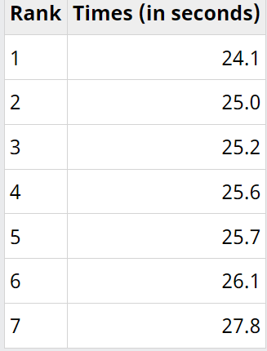
Median time in 200 meters of a top running athlete
Imagine that a top running athlete in a typical 200-metre training session runs in the following times: 26.1 seconds, 25.6 seconds, 25.7 seconds, 25.2 seconds, 25.0 seconds, 27.8 seconds and 24.1 seconds. How would you calculate his median time?
Let’s start with arranging the values in increasing order:
Rank associated with each value of 200-meter running times

Slide 38
Median time in 200 meters of a top running athlete
There are n = 7 data points, which is an uneven number. The median will be the value of the data points of rank
(n + 1) ÷ 2 = (7 + 1) ÷ 2 = 4.
The median time is 25.6 seconds.

Slide 39
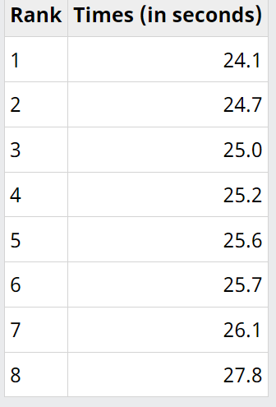
Median time in 200 metres of a top running athlete (Part 2)
If the number of data points is even, the median will be the average of the data point of rank n ÷ 2 and the data point of rank (n ÷ 2) + 1.
Rank associated with each value of 200-meter running times, updated

Slide 40
Median time in 200 metres of a top running athlete (Part 2)
There are now n = 8 data points, an even number. The median is the mean between the data point of rank
n ÷ 2 = 8 ÷ 2 = 4
and the data point of rank
(n ÷ 2) + 1 = (8 ÷ 2) +1 = 5
Therefore, the median time is (25.2 + 25.6) ÷ 2 = 25.4 seconds.

Slide 41
Relative frequency & Cumulative frequency
For larger data sets, the cumulative relative frequency distribution can be helpful to identify the median.
The median is the smallest value for which the cumulative relative frequency is at least 50%.
However, when possible it’s best to use the basic statistical function available in a spreadsheet or statistical software application because the results will then be more reliable.

Slide 42
Relative frequency & Cumulative frequency
Relative frequency
Relative Frequency is the frequency of an observation with respect to the total number of observations. The relative frequency of an object is calculated by using the formula Relative frequency = f/n where f is the frequency of an observation and n is the total frequency of the observation of the data set.
Cumulative frequency
The cumulative frequency is calculated by adding each frequency from a frequency distribution table to the sum of its predecessors. The last value will always be equal to the total for all observations, since all frequencies will already have been added to the previous total.
Cumulative frequency
This method is defined as the percentage of observations falling in each class interval. Relative cumulative frequency can be found by dividing the frequency of each interval by the total number of observations.

Slide 43
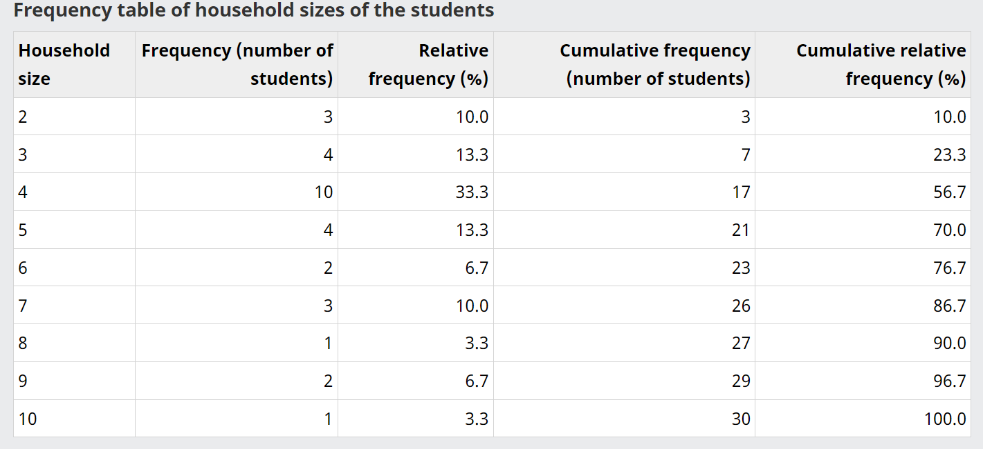
Relative frequency & Cumulative frequency
Example
Imagine you ask the 30 students of your class how many people there are in their households. You summarize the data you collected in a frequency table, in which you include the relative frequencies and the cumulative relative frequencies.

Slide 44
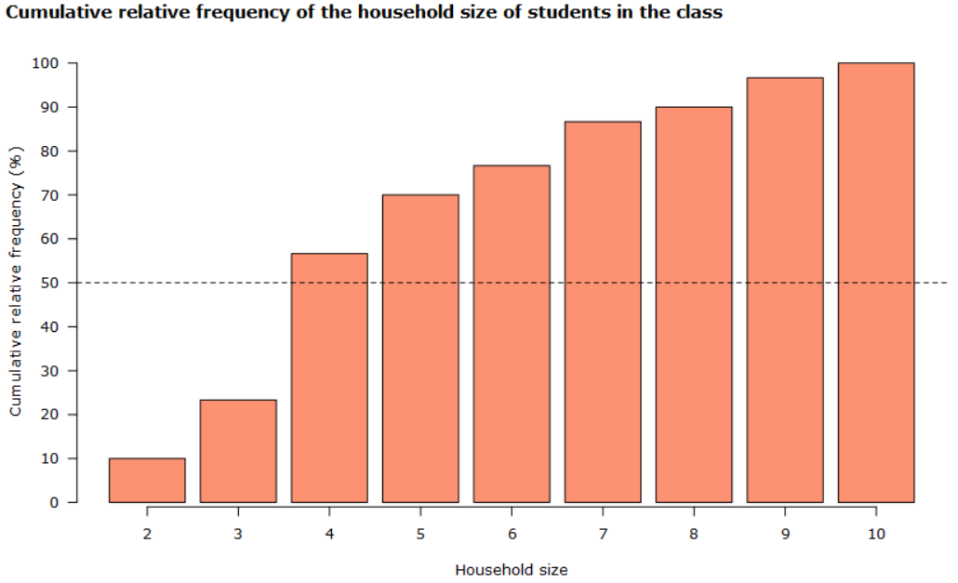
Relative frequency & Cumulative frequency

Slide 45
Relative frequency & Cumulative frequency
You can see that 10% of students (3 students) live in a household of size 2, 23% of students (7 students) live in a household of size 3 or less and 57% of students (17 students) live in a household of size 4 or less. The median will be equal to 4 because it’s the smallest value for which the cumulative relative frequency is higher than 50%. This is even more obvious if you visualize the cumulative relative frequency on a bar chart like on chart 4.4.2.1. The dotted line indicates the cumulative relative frequency of 50%.
The mean is the total number of people in the households of the students:
2 × 3 + 3 × 4 + 4 × 10 + 5 × 4 + 6 × 2 + 7 × 3 + 8 × 1 + 9 × 2 + 10 × 1 = 147
divided by the number of students, which is 30.
The result is 147 ÷ 30 = 4.9 people per household.
In this example, the median (4) is lower than the mean (4.9).

Slide 46
Calculating the mode
Mode is a statistical concept used to describe the most frequently occurring value in a given set of data. It is a measure of central tendency that is commonly used in data analysis, alongside mean and median. Unlike mean and median, which calculate the average and middle value of a dataset respectively, mode simply identifies the value that appears most frequently.
The mode can be used to summarize categorical variables, while the mean and median can be calculated only for numeric variables. This is the main advantage of the mode as a measure of central tendency. It’s also useful for discrete variables and for continuous variables when they are expressed as intervals.
Types of Mode in Statistics
Unimodal
Bimodal
Trimodal
Multimodal

Slide 47
Calculating the mode
Unimodal
When there is only one and only one mode of any dataset, then that dataset is called a unimodal dataset.
For example, In set X = {1, 2, 2, 3, 6, 7, 7, 7, 8, 9}, only 7 appears thrice. Thus, there is only one mode of the dataset X.
Bimodal
When there exist two modes in the given data set, then it is called a bimodal.
For example, In Set A = {1,1,1,3,4,4,6,6,6} the mode is 1 and 6 because both 1 and 6 have the highest frequency in the given set.
Trimodal
When there exist three modes in the given data set, then it is called trimodal.
For example, In Set A = {2, 2, 2, 3, 4, 4, 6, 6, 6, 7, 9, 9, 9} the mode is 2, 6, and 9 because 2, 6, and 9 have the highest frequency in the given set.
Multimodal
When there are four or more modes in the given data set, then it is called multimodal.
For example, In Set A = {1, 1, 1, 3, 4, 4, 6, 6, 6, 7, 9, 9, 9, 11, 11, 11} 1, 6, 9, and 11 are the mode because 1, 6, 9, and 11 have the highest frequency in the given set.

Slide 48
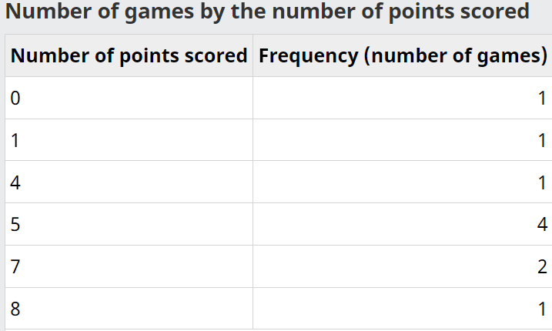
Calculating the mode
During a hockey tournament, Audrey scored 7, 5, 0, 7, 8, 5, 5, 4, 1 and 5 points in 10 games. After summarizing the data in a frequency table, you can easily see that the mode is 5 because this value appears the most often in the data set (4 times). The mode can be considered a measure of central tendency for this data set because it’s unique.

Slide 49
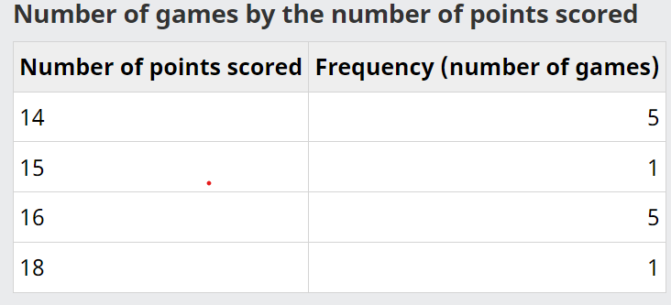
Calculating the mode
During Marco’s 12-game basketball season, he scored 14, 14, 15, 16, 14, 16, 16, 18, 14, 16, 16 and 14 points. After summarizing the data in a frequency table, you can see that there are two modes in this data set: 14 and 16. Both values appear 5 times in the data set and 5 is the highest frequency observed. The mode can’t be used a measure of central tendency because there is more than one mode. It’s a bimodal distribution.

Slide 50
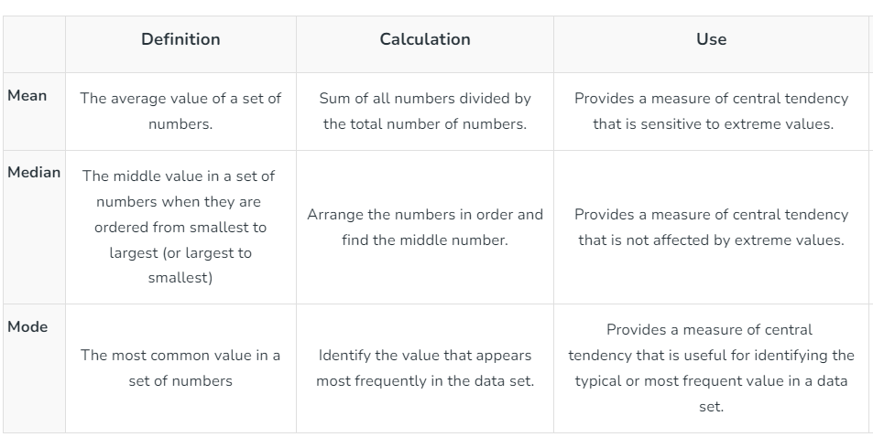
Mean Vs Median Vs Mode

